Slide 1
Foreign Direct Investment (FDI)
Analysis

Slide 2
Introduction to FDI
Foreign Direct Investment (FDI) analysis involves the examination of trends, patterns, and factors influencing the flow of investment from foreign entities into a country's economy. FDI plays a crucial role in a nation's economic growth and development by bringing in capital, technology, expertise, and access to new markets.

Slide 3
Key Components of FDI
Trend Analysis
Sectoral Analysis
Regional Analysis
Policy Analysis
Comparative Analysis
Sectoral Dynamics
Risk Analysis

Slide 4
Problem Statement
Investment is a game of understanding historic data of investment objects under different events but it is still a game of chances to minimize the risk we apply analytics to find the equilibrium investment.
To understand the Foreign direct investment in India for the last 17 years from 2000-01 to 2016-17. This dataset contains sector and financial year-wise data of FDI in India Sector-wise investment analysis Year-wise investment analysis.
Find key metrics and factors and show the meaningful relationships between attributes. Do your own research and come up with your findings

Slide 5
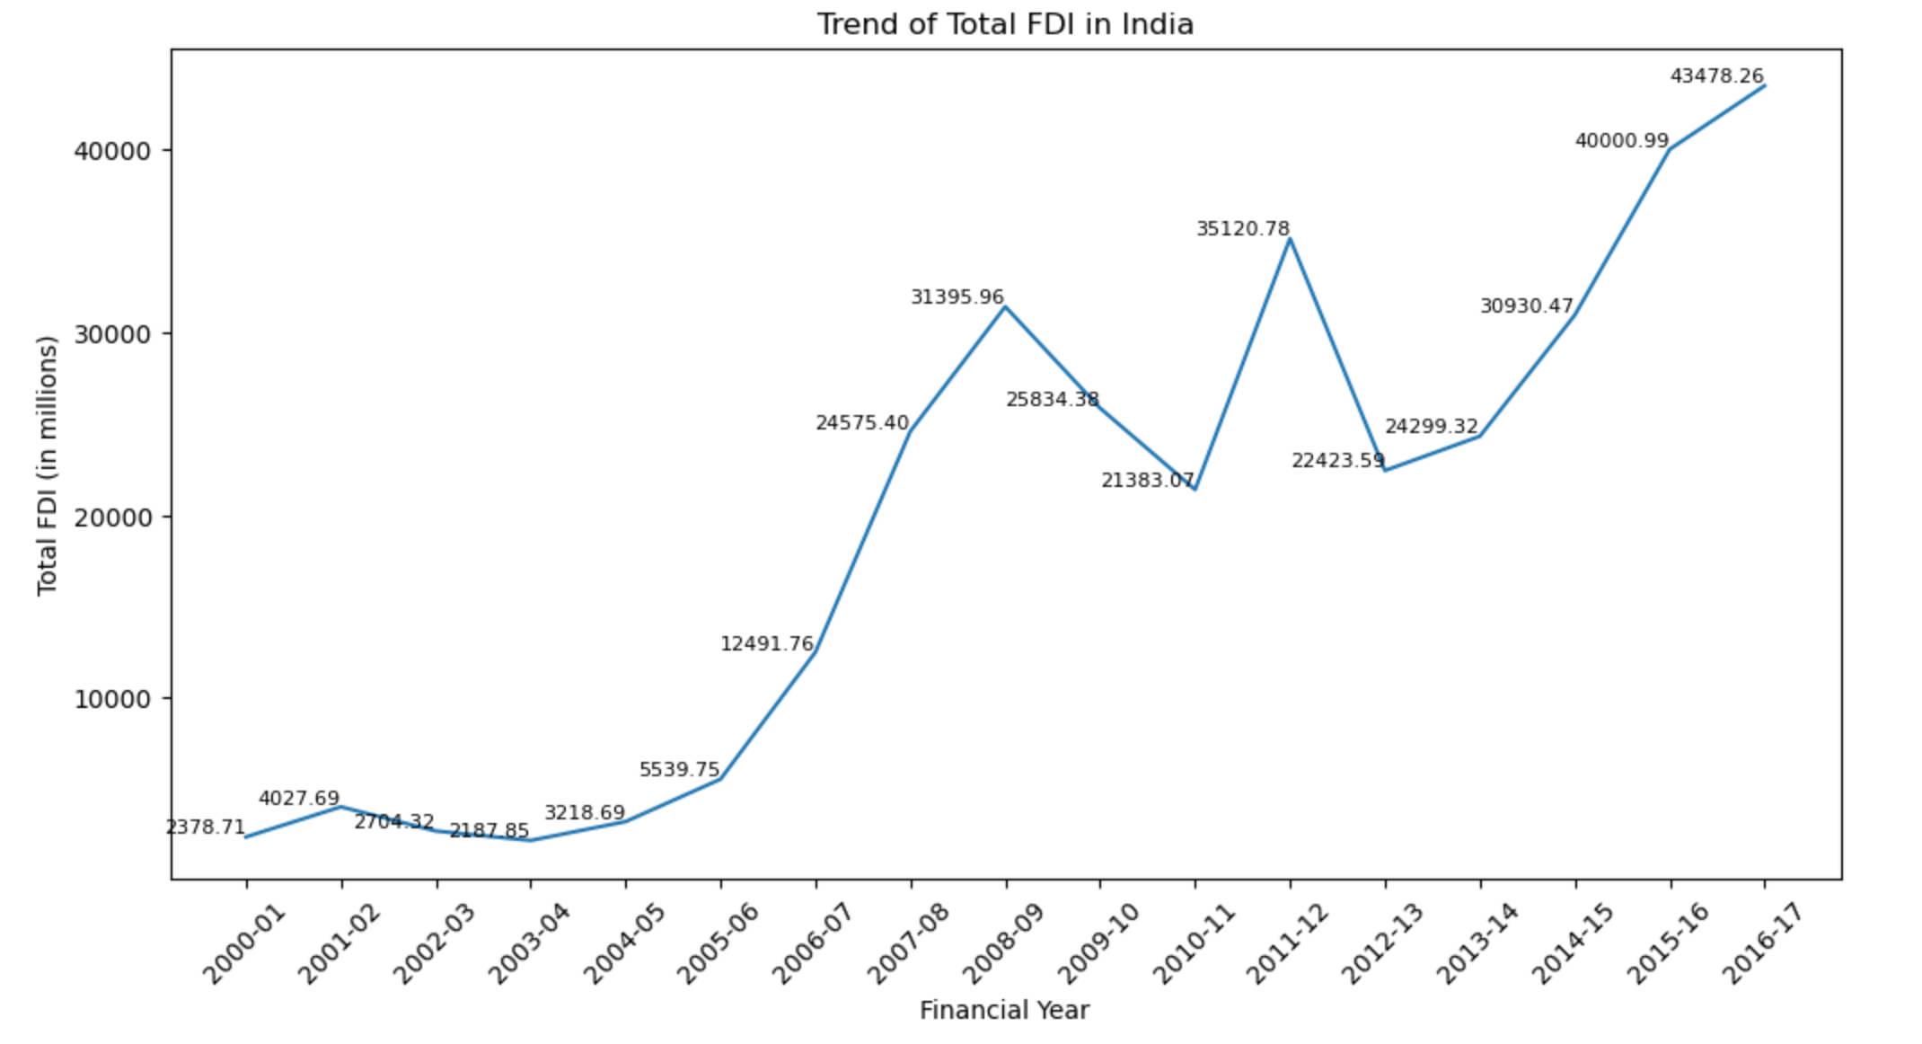
Trend of Total FDI in India
Overall Upward Trend
FDI in India has generally increased over the 17 years from 2000-01 to 2016-17. It went up from about 2,378 million USD in 2000-01 to 43,478 million USD in 2016-17, showing that more and more investors are interested in India.
Periods of Significant Growth
There were specific times when FDI grew a lot. From 2005-06 to 2008-09, FDI nearly tripled from around 5,540 million USD to about 31,396 million USD. Another big growth period was from 2013-14 to 2016-17, when FDI went up from about 24,299 million USD to 43,478 million USD. This shows that investors had a lot of confidence in the Indian economy during these times.

Slide 6
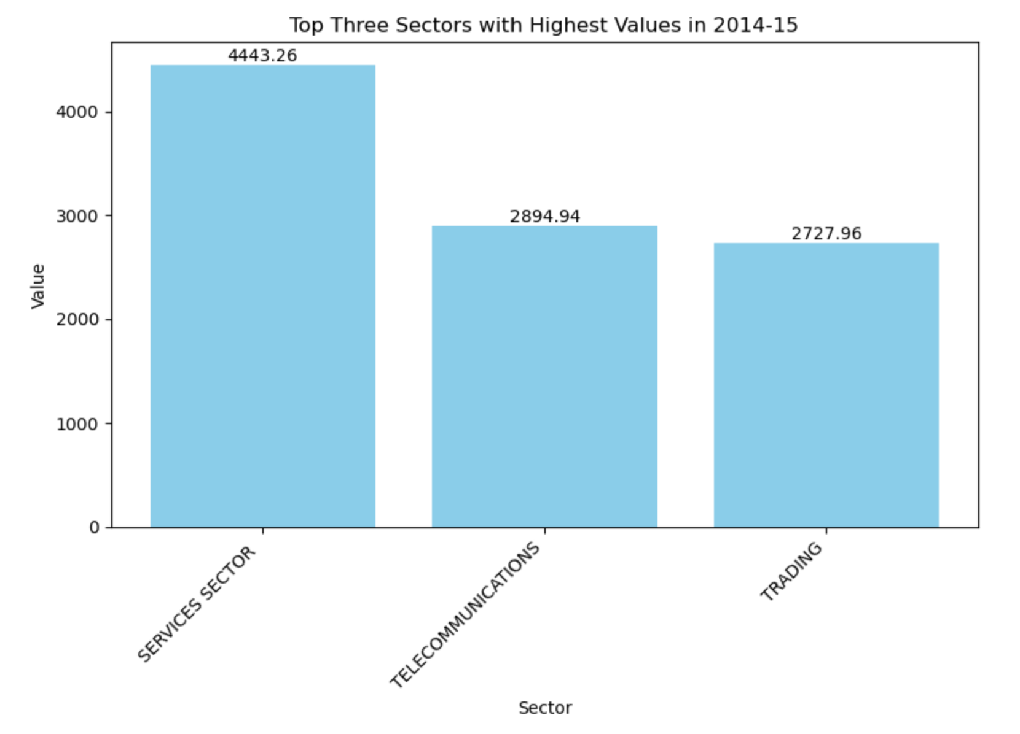
Top three sectors with Highest values in 2014-15
Services Sector Dominance
In 2014-15, the services sector got the most FDI, totaling 4,443.26 million USD. This shows how important the services sector is for attracting foreign investment, likely because of the availability of skilled workers, growth in areas like IT, and the potential for exporting services.
Telecommunications and Trading Sectors
In 2014-15, the telecommunications and trading sectors were the next largest recipients of FDI, receiving 2,894.94 million USD and 2,727.96 million USD, respectively. This indicates that these sectors are also key for foreign investors, possibly due to rising demand, better infrastructure, and favorable regulatory changes.

Slide 7
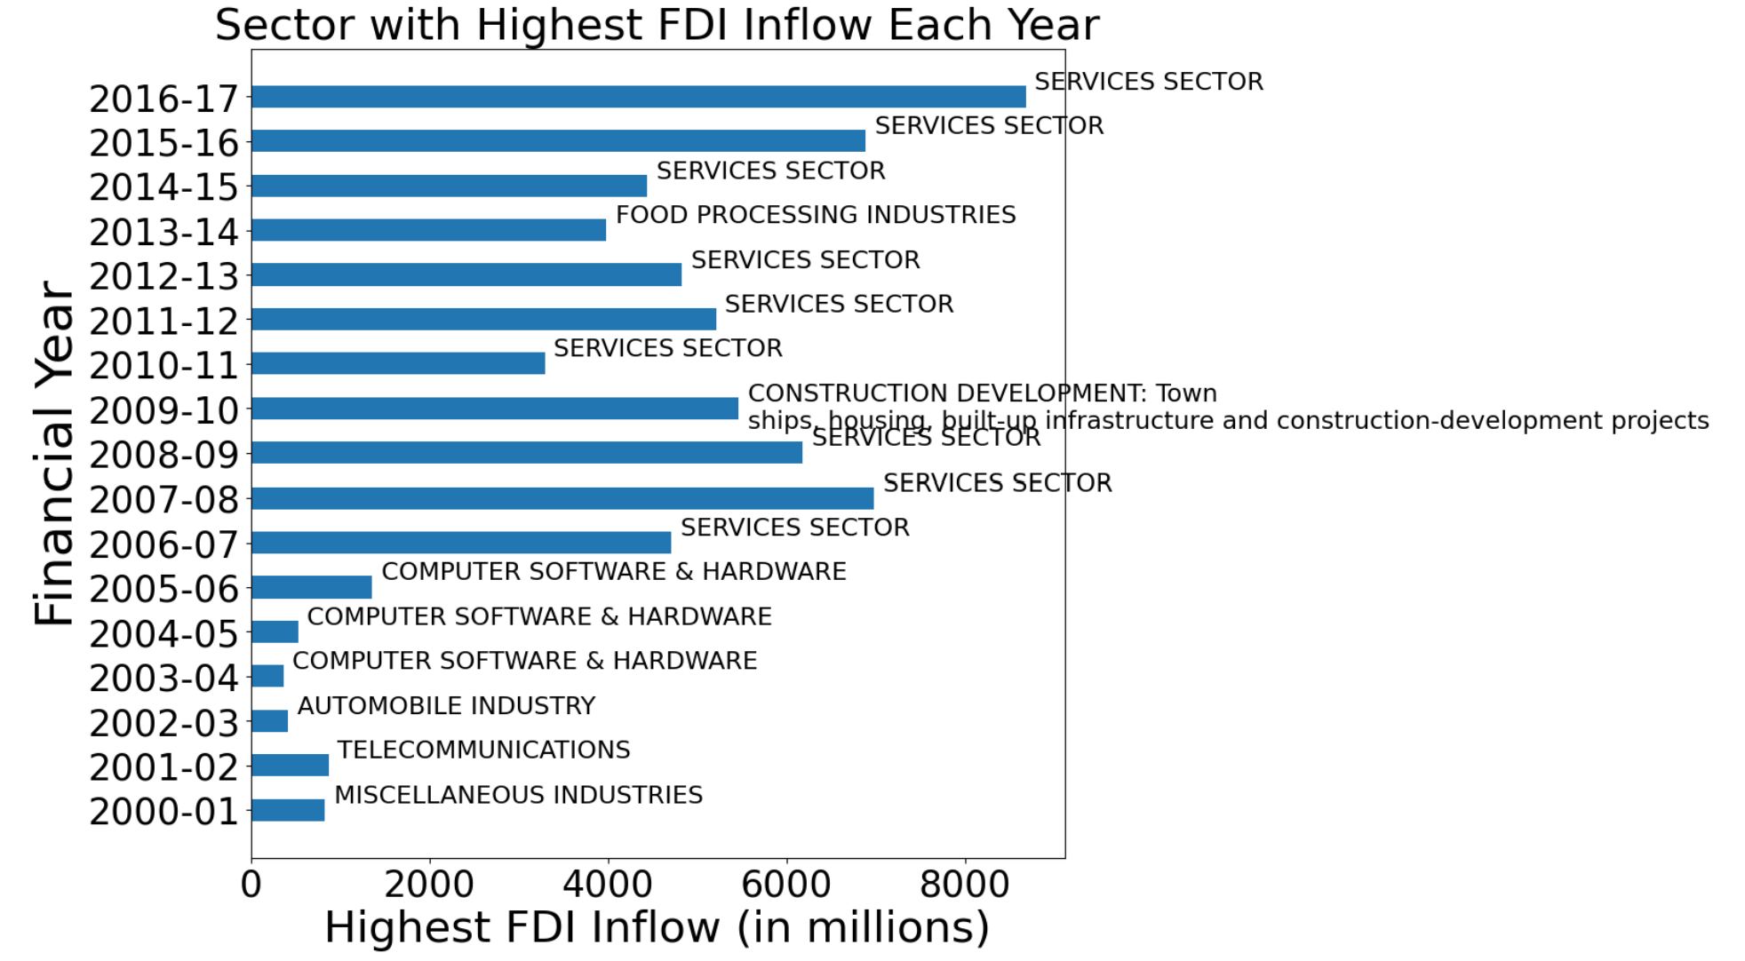
Sector with Highest FDI Inflow Each year
Dominance of the Services Sector
From 2006-07 to 2016-17, the services sector, including IT, telecommunications, and financial services, consistently attracted the most FDI. This shows that foreign investors find India's services industry very appealing, likely because of the skilled workforce and growth opportunities.
Shift from Computer Software & Hardware to Other Sectors
In the early years (2003-04 to 2005-06), the computer software and hardware sector received the most FDI. But in recent years, other sectors like food processing (in 2013-14) and construction development (in 2009-10) have become top FDI recipients. This shift indicates that foreign investment is spreading to various sectors in India, influenced by policy changes, better infrastructure, and evolving market trends.

Slide 8
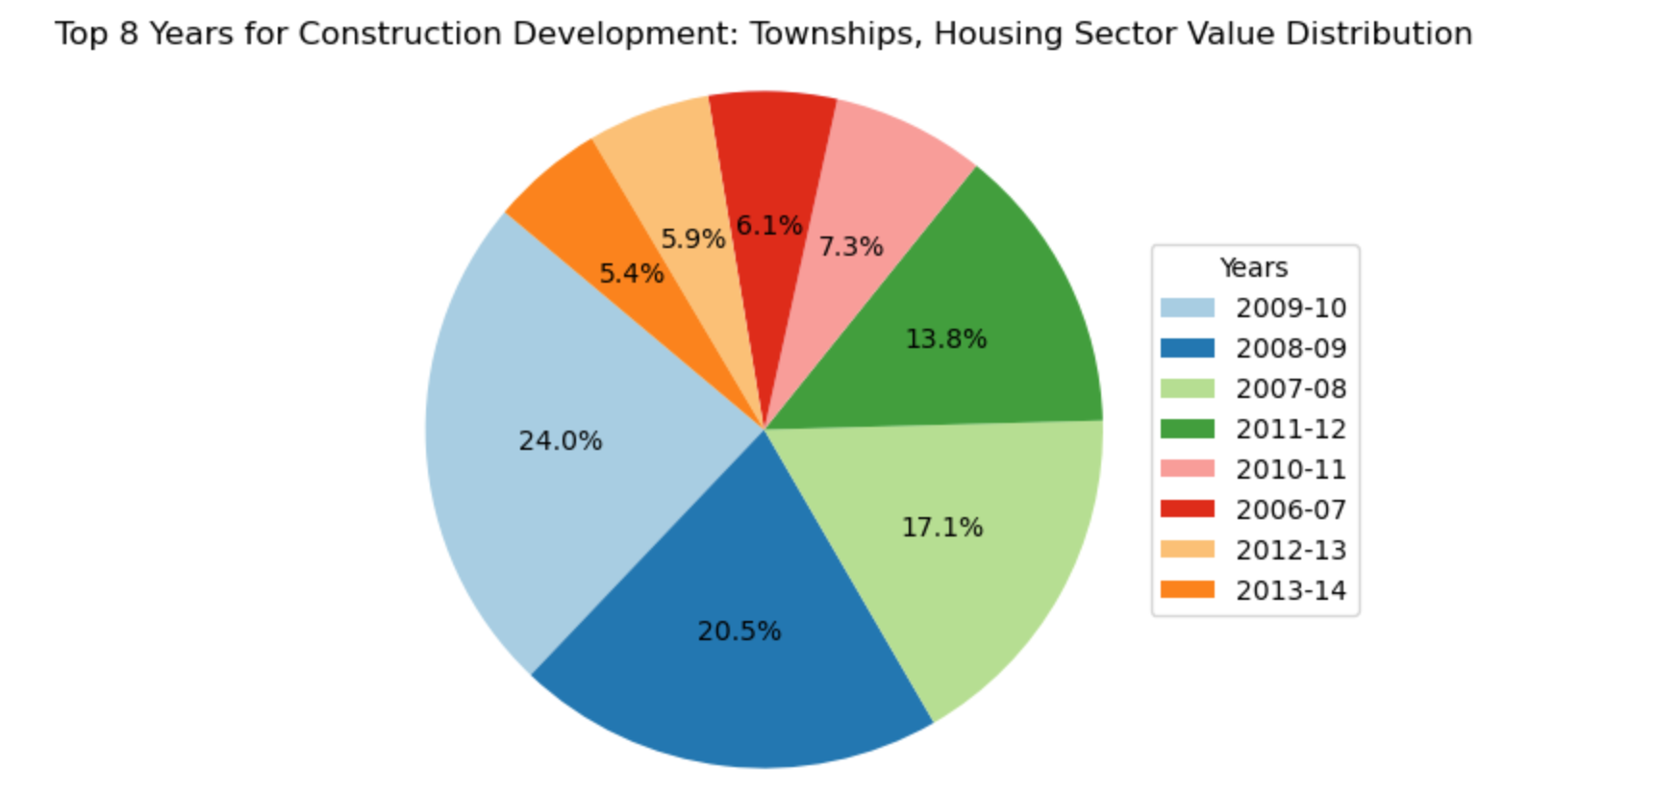
Top 8 Years for construction development: Townships, Housing Sector Value distribution
Highest Share in 2009-10
In 2009-10, the Construction Development sector (including townships and housing) received the highest share of FDI inflows at 24%. This may be due to the economic recovery after the global financial crisis, favorable policies for real estate, or increasing demand for housing and infrastructure projects.
Significant Fluctuations over the Years
The FDI inflows in the Construction Development sector have varied a lot over the years. For example, it was 24% in 2009-10 but dropped to 5.4% in 2010-11. Other years also showed big differences, like 13.8% in 2007-08 and 6.1% in 2006-07. These ups and downs could be due to changing economic conditions, regulations, investor confidence, or specific real estate initiatives.

Slide 9
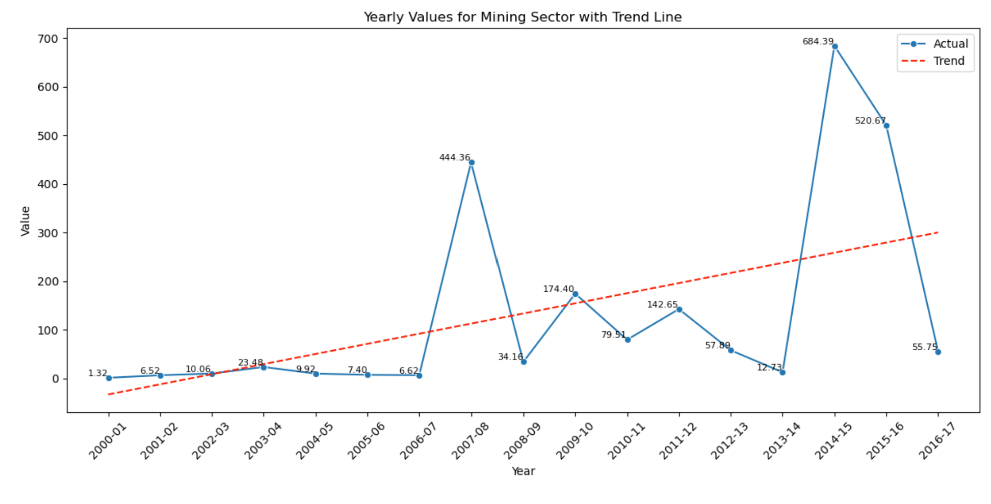
Yearly Values for Mining Sector with Trend Line
Significant Spike in 2015-16
In 2015-16, FDI in the Mining sector jumped to about 684.39 million USD, much higher than usual. This big increase could be due to specific events, new policies, or reforms that made the sector more attractive to foreign investors.
Overall Increasing Trend
Despite some ups and downs, FDI in the Mining sector has generally been going up over the years. This shows that the sector is becoming more appealing to foreign investors, likely due to economic growth, higher demand for resources, policy changes, or better infrastructure and technology in mining.

Slide 10
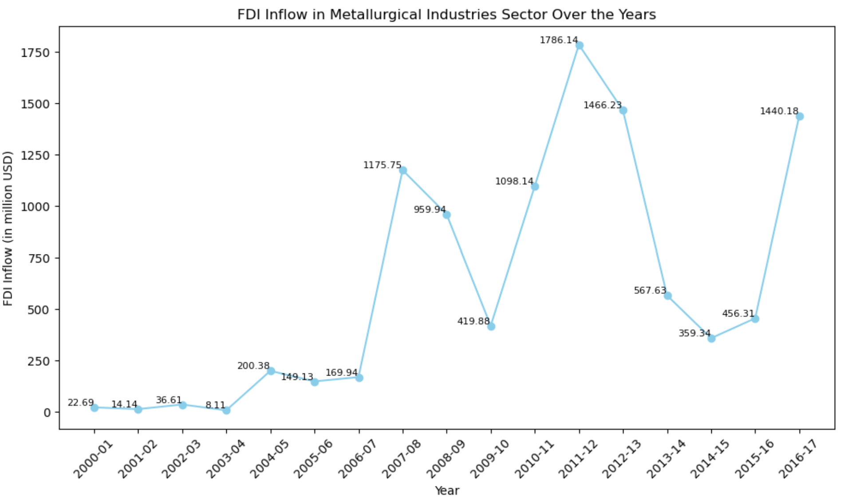
FDI Inflow in Metallurgical Industries Sector Over the years
Highly Volatile Inflows
The graph shows that FDI in this sector has been very up and down over the years. There were high peaks in 2008-09 and 2013-14, with inflows over 1700 million USD, and low points in 2003-04 and 2011-12, with inflows below 200 million USD. This volatility could be due to factors like changes in global commodity prices, domestic policies, or large investment projects in specific years.
Overall Upward Trend in Recent Years
Despite the ups and downs, FDI in this sector has generally been increasing in recent years. After dropping to about 360 million USD in 2012-13, inflows have mostly gone up each year, reaching around 1440 million USD in 2016-17. This suggests growing investor interest and confidence in India's metallurgical industries recently.

Slide 11
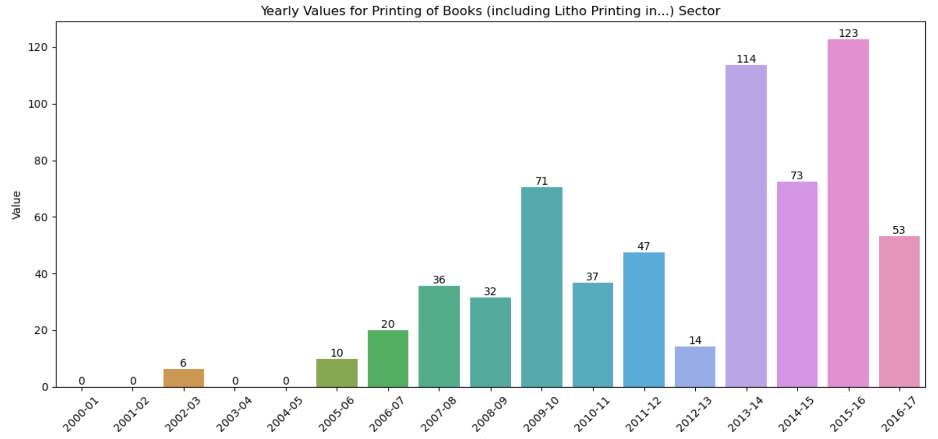
Yearly values for printing of Books (including Litho Printing in…) Sector
Sustained Growth in Recent Years
The graph shows that FDI in the publishing and printing sector has steadily increased from 2011-12 onwards. It rose from just 14 million USD in 2011-12 to 123 million USD in 2016-17, indicating growing investor interest and confidence in this industry over the past 5-6 years.
Low Historical Inflows
Despite recent growth, FDI in this sector has historically been low. From 2000-01 to 2010-11, inflows were mostly below 50 million USD, with some years even having little to no investment. This could be due to factors like a small market, limited growth opportunities, or policy barriers that discouraged foreign investment during those years.

Slide 12
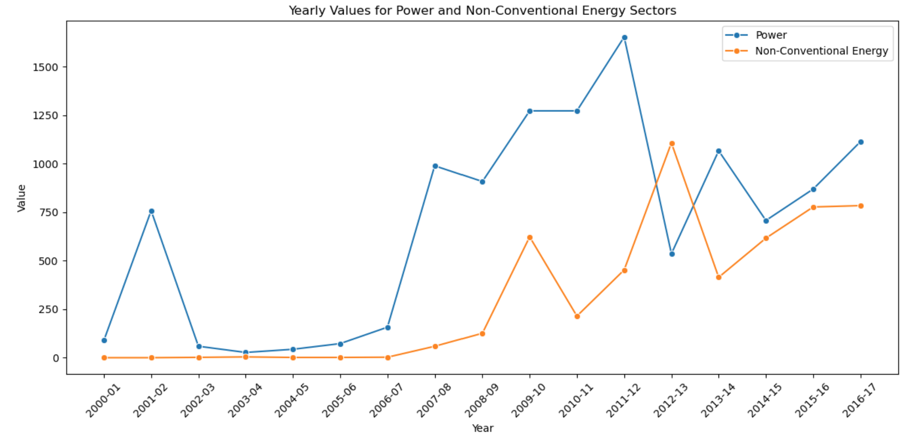
Yearly Values for power and Non-conventional Energy Sectors
Power Sector Dominates Inflows
The Power sector has received much higher FDI compared to the Non-Conventional Energy sector. Major spikes occurred in 2007-08 and 2015-16, with inflows exceeding 1200 million USD. In contrast, the highest inflow for Non-Conventional Energy was around 600 million USD in 2016-17. This difference is likely because power projects are larger, have more established investor interest, and benefit from more supportive policies.
Recent Surge in Non-Conventional Energy Inflows
Though historically lower, FDI in the Non-Conventional Energy sector has surged in recent years, especially from 2014-15 onwards. After being below 200 million USD for most years, inflows exceeded 500 million USD in 2016-17. This increase is likely due to growing global interest in renewable energy, India's focus on this sector, better investment opportunities, and technological advances making these projects more feasible.

Slide 13
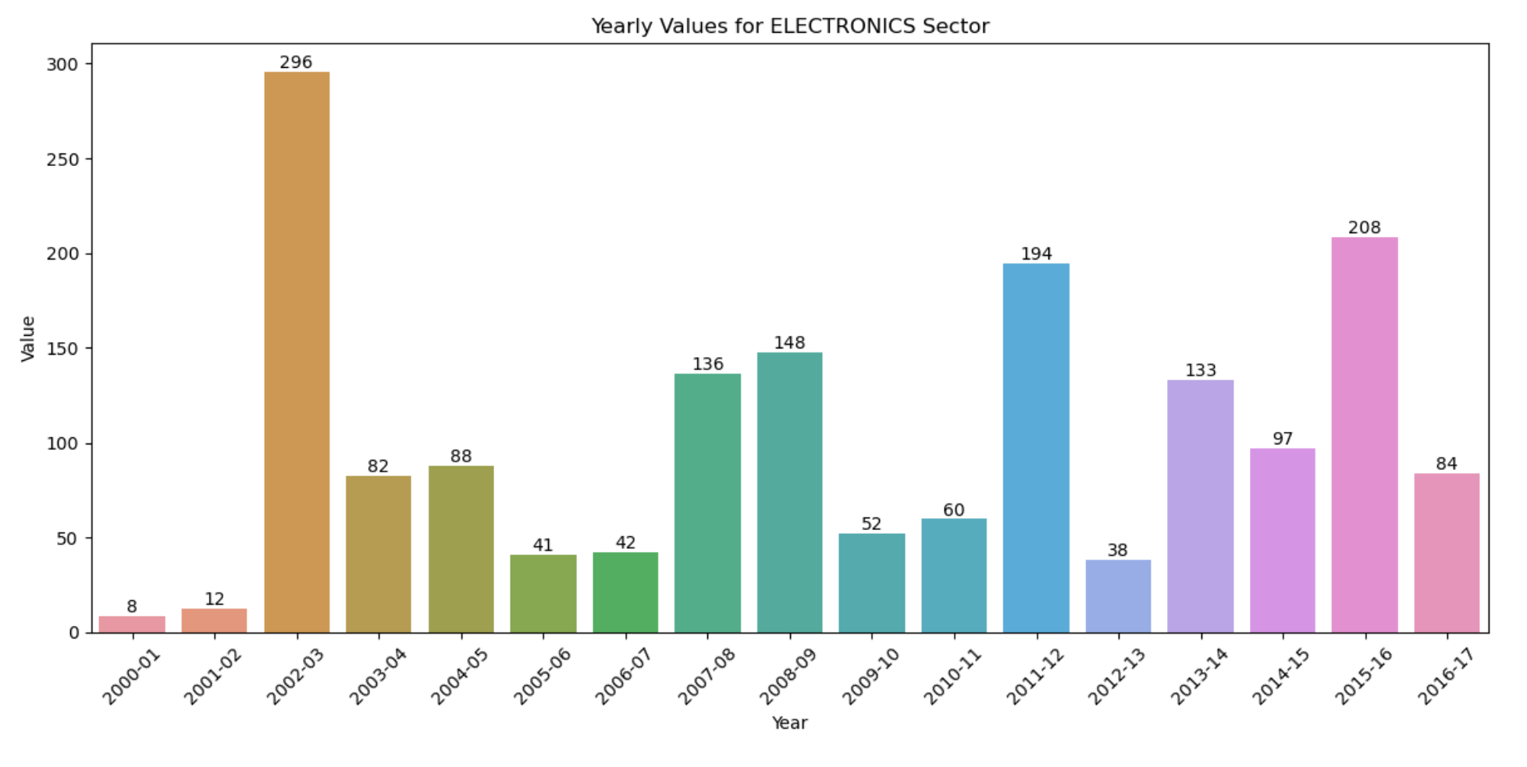
Yearly Values for Electronics Sector
Highly Volatile Inflows
The graph shows that FDI inflows into this sector have been very unpredictable over the years. There were big spikes, like in 2000-01 (296 million USD) and 2010-11 (194 million USD), as well as years with very low inflows, around 8-12 million USD in the early 2000s. This volatility could be because of changes in domestic policies, major projects in certain years, or global economic conditions affecting the electronics industry.
Recent Stabilization at Moderate Levels
Although historically unpredictable, recent years have seen some stabilization, with inflows staying around 80-130 million USD from 2013-14 onwards. While not reaching peak levels, this steady moderate inflow suggests growing but stable investor interest in India's electronics sector. Possible reasons include the government's encouragement of electronics manufacturing, industry incentives, and India's large consumer market.

Slide 14
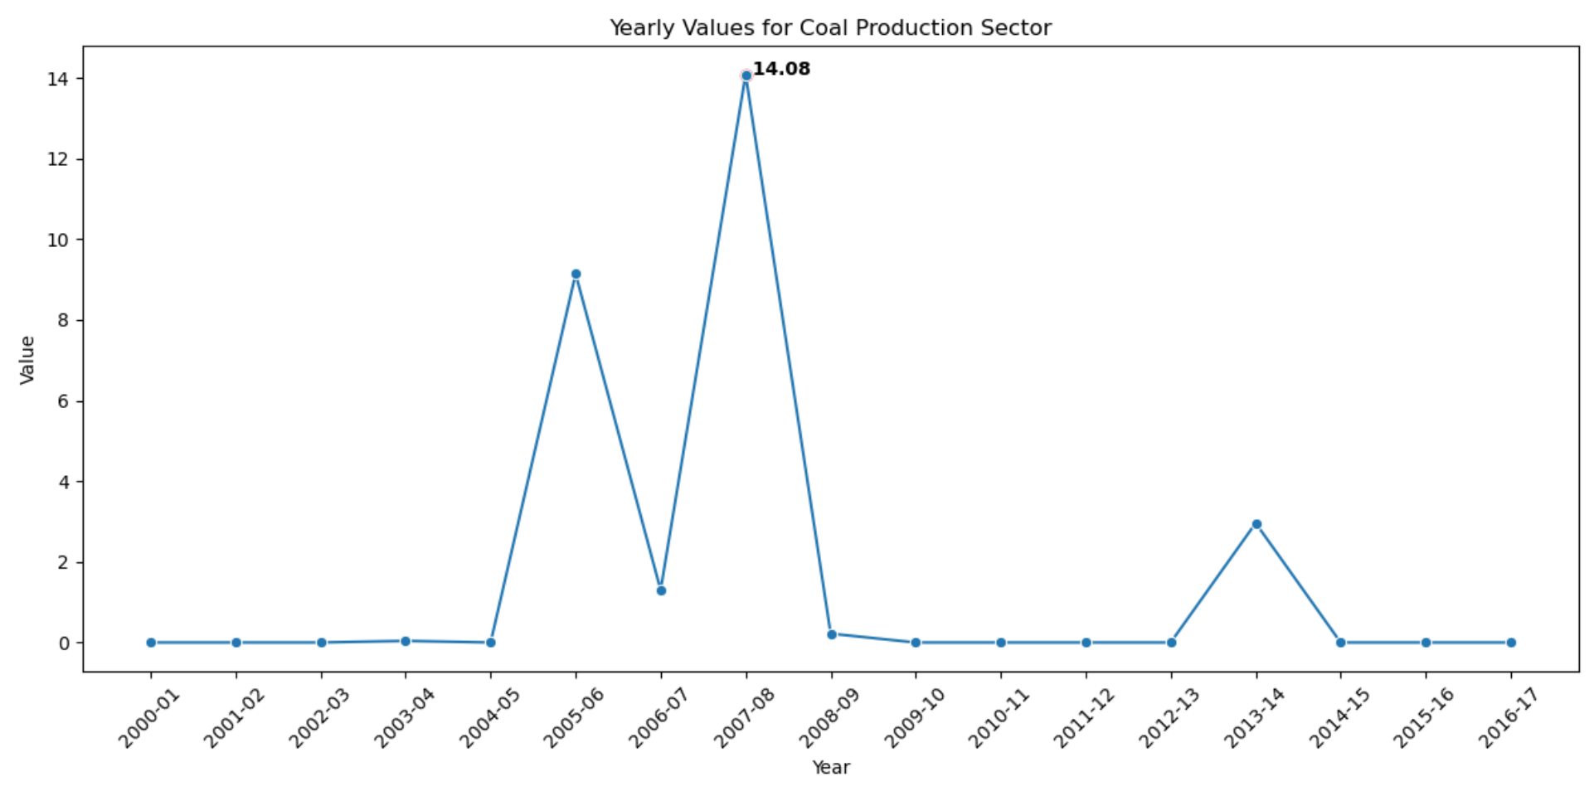
Yearly Values for Coal Production Sector
Highly Concentrated Inflows in Specific Years
The graph shows big spikes in FDI inflows during certain years, notably in 2007-08 and 2013-14, each around 14 million USD. However, in most other years, inflows are very low or close to zero. This suggests that foreign investments in this sector might be tied to specific large projects or policy changes in those years, rather than being part of a consistent trend.
Overall Declining Trend in Recent Years
Despite the spikes in 2007-08 and 2013-14, there's an overall decline in FDI inflows into the Coal Production sector, especially from 2014-15 onwards. This could be because of concerns about the environment, a shift towards renewable energy sources, changes in regulations, or investors seeing the coal industry as less viable in the long term.

Slide 15
Conclusion
Overall Upward Trend: FDI in India has generally increased over the years, reflecting growing investor interest, rising from 2,378 million USD in 2000-01 to 43,478 million USD in 2016-17.
Periods of Significant Growth: Certain periods, notably from 2005-06 to 2008-09 and from 2013-14 to 2016-17, witnessed substantial increases in FDI, indicating confidence in India's economy.
Dominance of the Services Sector: The services sector consistently attracted the most FDI, driven by factors such as skilled labor availability and growth prospects in areas like IT and telecommunications.
Shift in Investment Focus: While computer software and hardware initially dominated FDI, recent years have seen diversification into sectors like food processing and construction development.
Sector-specific Dynamics: Sectors like construction development and mining experienced significant fluctuations in FDI, influenced by economic conditions, policy changes, and project-specific factors.
Emerging Trends: Sectors like publishing and printing and non-conventional energy have seen recent growth in FDI, indicating evolving investor preferences and policy support.
Sector Disparities: Power sectors have historically attracted higher FDI than non-conventional energy, but recent years have seen a surge in the latter, reflecting changing energy dynamics.
Volatility and Stability: Some sectors, like electronics, have experienced highly volatile FDI, while others have shown more stability in recent years.
Conclusion: Overall, while certain sectors have seen fluctuations, the trend in FDI suggests a growing and diversifying interest in India's economy, driven by factors like policy reforms, economic growth, and sector-specific opportunities.

Slide 16
Thank You

